Slide 1
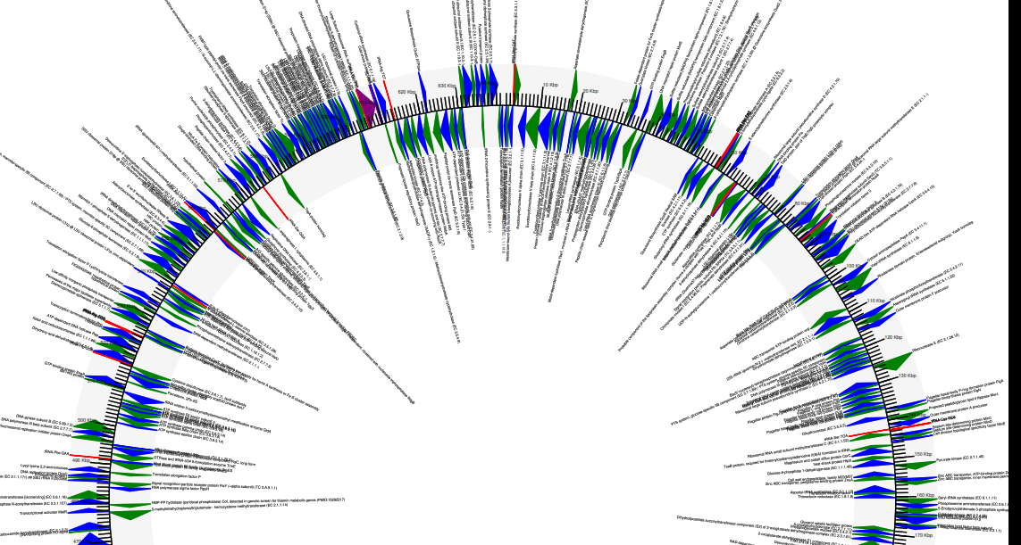
Transcriptomics RNA sequencing University of St Andrews Bioinformatic Unit (StABU) - Peter Thorpe

Slide 2
Overview
1: Gene structure
2: History (EST sequencing – Sanger) - brief.
3: Illumina
4: Biological reps
5: Differential expression between conditions
6: RNAseq as a guide for gene calls
7: Nanopore and PacBio (long read) RNAseq – holy grail?

Slide 3
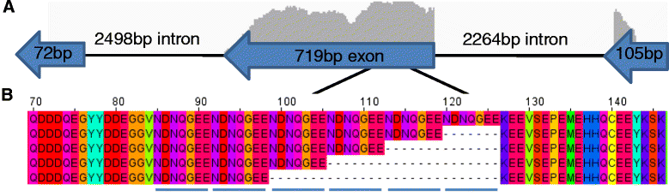
1) Eukaryotic Gene Structure
Eukaryotes have complex gene structure which can span MANY thousands of nucleotides (DO YOU ALREADY KNOW THIS???)
Can have many exons with, for example insects, 10,000s bp introns.
You have already heard that genomes can be VERY large, thus making it expensive and difficult to sequence. (Genome seq is still a huge advantage)
Thorpe, P., Cock, P.J. and Bos, J., 2016. Comparative transcriptomics and proteomics of three different aphid species identifies core and diverse effector sets. BMC genomics, 17(1), p.172.

Slide 4
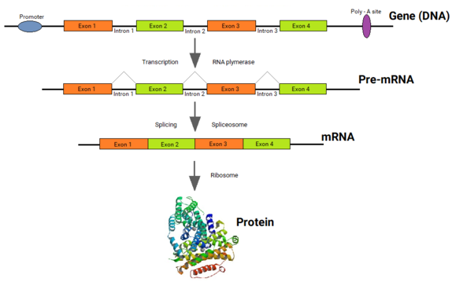
1) Eukaryotic Gene Structure
Eukaryotes have complex gene structure which can span MANY thousands of nucleotides
DNA
https://en.wikipedia.org/wiki/Split_gene_theory

Slide 5
1) Eukaryotic Gene Structure
Eukaryotes have complex gene structure which can span MANY thousands of nucleotides
start
end
Many different splicing patterns of the exons happen. E.g. 1,3,4 or 1,4 or 1,2,4. … 1,2,3,4
Or even 2,3,4 if an alternative start is present
https://en.wikipedia.org/wiki/Split_gene_theory

Slide 6
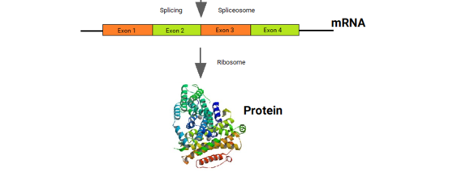
1) Eukaryotic Gene Structure
The final, spliced product which only contains the coding sequence is sent for sequencing. This is directly relevant to the protein sequence.
Thus, a MUCH smaller amount of data to deal with
start
end
https://en.wikipedia.org/wiki/Split_gene_theory

Slide 7
Overview
1: Gene structure
2: History (EST sequencing – Sanger) - brief.
3: Illumina
4: Biological reps
5: Differential expression between conditions
6: RNAseq as a guide for gene calls
7: Nanopore and PacBio (long read) RNAseq – holy grail?

Slide 8
2) EST sequencing: Old, not really done now
Sanger sequencing : RNA extraction -> cDNA -> Sanger sequencing
Very accurate, long reads. But VERY expensive and very low output
To cover a transcriptome: 20,000 genes. Most genes multi exon, therefore many transcripts variants = football player wages.
Micro arrays: This is now an outdated tool which measures fluorescence when “something/ RNA” bind to known spot containing DNA on a slide. Be aware it exists. Read more:
Hrdlickova, R., Toloue, M. and Tian, B., 2017. RNA‐Seq methods for transcriptome analysis. Wiley Interdisciplinary Reviews: RNA, 8(1), p.e1364.
https://www.nature.com/scitable/definition/microarray-202/#:~:text=A%20microarray%20is%20a%20laboratory,genes%20at%20the%20same%20time.&text=The%20DNA%20molecules%20attached%20to,by%20a%20group%20of%20genes.
https://www.frontiersin.org/articles/10.3389/fgene.2018.00636/full

Slide 9
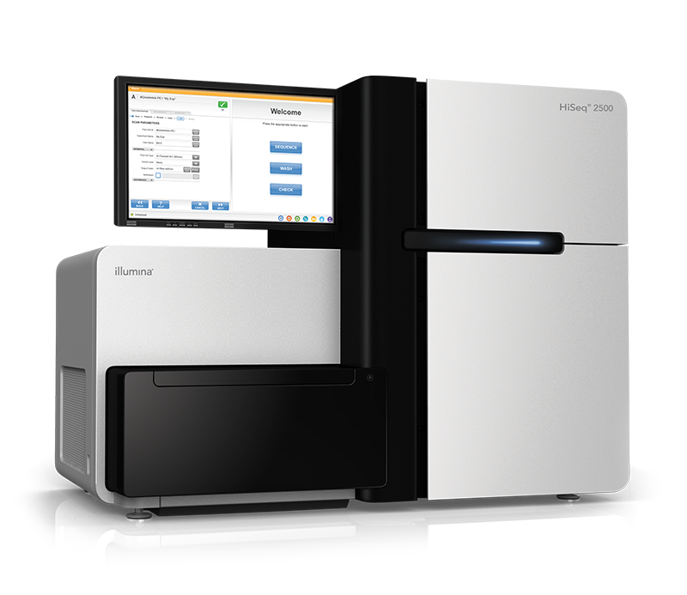
3) Illumina came along – yay!!
Lib prep: You have heard some details about library prep, but the important thing here is double poly AAA selection, thus purifying mRNA – poly AAA tail (versus DNA contamination and ribosomal RNA).
Huge amount of short accurate reads. = GOOD. Can now cover the transcriptome. (100 million reads per run can be achieved)
So much data = problem! (.. what you want to do with it)
https://emea.illumina.com/content/dam/illumina-marketing/documents/products/illumina_sequencing_introduction.pdf
https://www.illumina.com/systems/sequencing-platforms/hiseq-2500.html

Slide 10
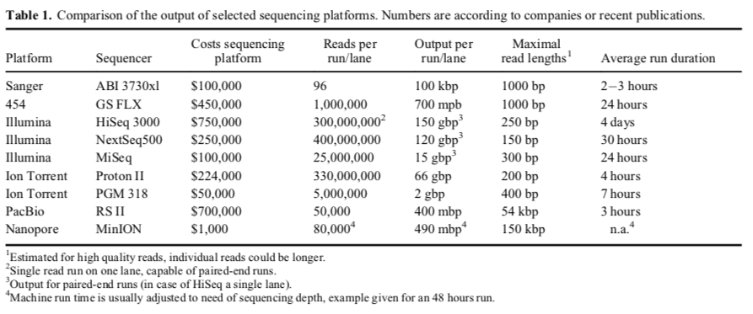
3) Sequencing comparisons
Bleidorn, Christoph (2016). “Third generation sequencing: technology and its potential impact on evolutionary biodiversity research”. Systematics and Biodiversity. 14 (1): 1–8. doi:10.1080/14772000.2015.1099575. ISSN 1477–2000. https://www.tandfonline.com/doi/abs/10.1080/14772000.2015.1099575?journalCode=tsab20

Slide 11
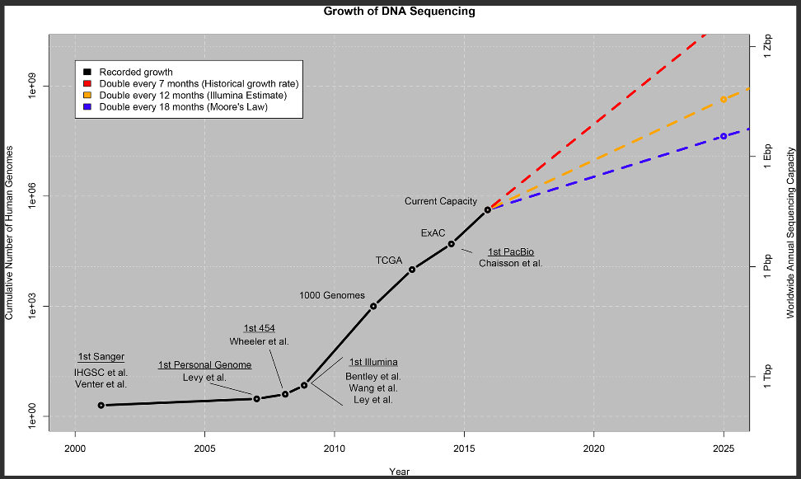
Bleidorn, Christoph (2016). “Third generation sequencing: technology and its potential impact on evolutionary biodiversity research”. Systematics and Biodiversity. 14 (1): 1–8. doi:10.1080/14772000.2015.1099575. ISSN 1477–2000. https://www.tandfonline.com/doi/abs/10.1080/14772000.2015.1099575?journalCode=tsab20

Slide 12
3) Illumina: RNAseq data
Just to “quantify expression“ (more later) of already known genes, the huge amount of data is not a problem except storage space.
De novo assembly: Overlap consensus just like genome assembly would not work.
Solution: Kmers and de bruijn graph (this does lead to other shortcomings). Assemble with Trinity: https://github.com/trinityrnaseq/trinityrnaseq/wiki
https://www.illumina.com/systems/sequencing-platforms/hiseq-2500.html

Slide 13
Overview
1: Gene structure
2: History (EST sequencing – Sanger) - brief.
3: Illumina
4: Biological reps, gene expression and counts
5: Differential expression between conditions
6: RNAseq as a guide for gene calls
7: Nanopore and PacBio (long read) RNAseq – holy grail?

Slide 14
4) Biological replicas
Biological replicas (reps): Very important. How many? See reference!
Ideally, to see 85% of DE genes at 4 fold expression change (LOG2), you need 20 reps - time collecting samples and money, this may not be possible.
3 reps is very common: But this only found 20-40% of DE genes in the analysis (see paper). Is that OK?
If you have a low number of reps (<7): Best DE tools are EdgeR and DESEQ2 as they have good false discovery rate filters (FDR).
TAKE HOME MSG: The more reps the better!
Schurch, N.J., Schofield, P., Gierliński, M., Cole, C., Sherstnev, A., Singh, V., Wrobel, N., Gharbi, K., Simpson, G.G., Owen-Hughes, T. and Blaxter, M., 2016. How many biological replicates are needed in an RNA-seq experiment and which differential expression tool should you use?. Rna, 22(6), pp.839-851.

Slide 15
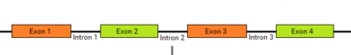
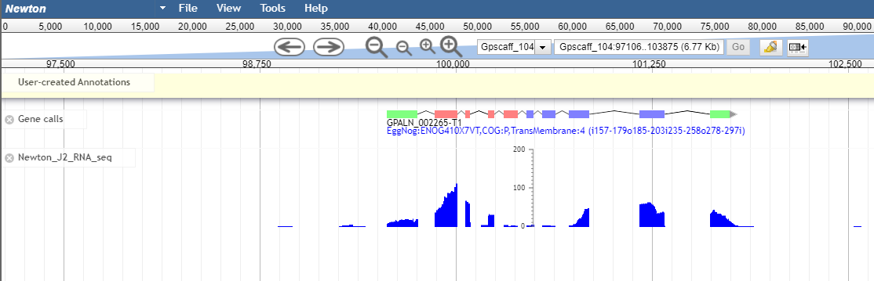
4) Quantify gene expression: Splice aware aligner
As intron are not present in the RNA, we need an aligner than is “aware” of this – STAR https://github.com/alexdobin/STAR
RNAseq read(s)
Genome seq
Real example

Slide 16
4) Quantify gene expression: quasi mapping
Map directly to the predict nucleotide genes/ transcripts: Salmon
https://combine-lab.github.io/salmon/
Index the gene calls or transcriptome using a kmer frequency. Then it matches the reads based on the kmer matches.
Super fast. Current thinking is this is accurate. Less control over highly duplicated mapping results.

Slide 17
4) Normalisation of technical bias
Technical variation sources: Sample collection, time points, processing, PCR, Lib prep, seq machine, QC trimming, base calling, mpapping …. LOTS!!!
Biological reps are essential for the tool (EdgeR) to gain an estimate of the technical variation.
Once an estimation of the technical variation is obtained, normalisation of the dataset can be performed prior to analysis.
Thus, in theory only doing analysis on the biological variation (what we want)

Slide 18
4) Normalisation of gene expression
If Lib prep was performed at different times, the variation in this will be greater than that of the biological signal and batch effect removal needs to be applied. EdgeR
To account for gene sizes, and therefore the bias in sequencing the longer genes and library sizes: TMM-FPKM (trimmed mean of means fragments per kilo million) and/ or TPM (transcripts per million) normalisation is used. (others: counts per million, relative log normalisation…)
https://davetang.org/muse/2011/01/24/normalisation-methods-for-dge-data/

Slide 19
Overview
1: Gene structure
2: History (EST sequencing – Sanger) - brief.
3: Illumina
4: Biological reps, gene expression and counts
5: Differential expression between conditions
6: RNAseq as a guide for gene calls
7: Nanopore and PacBio (long read) RNAseq – holy grail?

Slide 20


5) What is differential expression
To use a obvious example: If eyes were dissected out of human heads, sequenced and compared to the sequencing output of the liver. You would expect to find eye specific gene expression in one sample and liver specific expression in the other. (plus some genes that are the same “housekeeping” genes)
If an Exact test was applied to such data you would find gene significantly upregulated in one sample versus the other.
vs

Slide 21
5) What is differential expression
Therefore we set up experiments to try to find genes/ exons/ transcripts upregulated or down regulated in a condition or phenotype of interest.
.. Candidates for further experimentation.
…. Lets suppose we have our experiment and our gene counts. What next ….

Slide 22
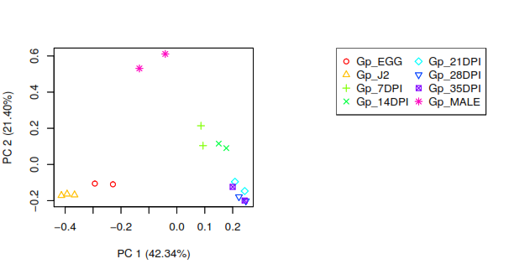
5) Quality control before DE
Principle component analysis (PCA) of the raw counts: Can you separate your biological conditions? Do your reps cluster together?
PCA: https://en.wikipedia.org/wiki/Principal_component_analysis

Slide 23
5) Quality control before DE
Principle component analysis of the raw counts: Can you separate your biological conditions? Do your replicas cluster together? This is important to see if your data can be used.
These conditions cannot be separated.
% of the variation explained by the first and major axis

Slide 24
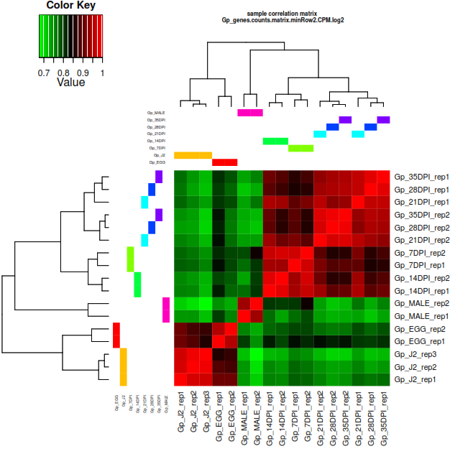
5) Quality control before DE
Hierarchical clustering of expression to determine how similar the samples are. Can you separate your biological conditions? Do your reps cluster together?
These conditions cannot be separated.

Slide 25
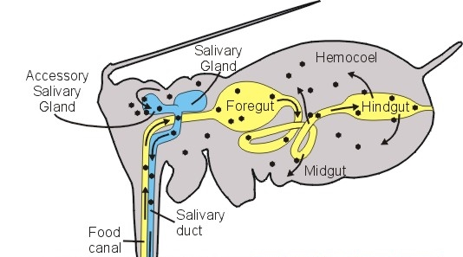
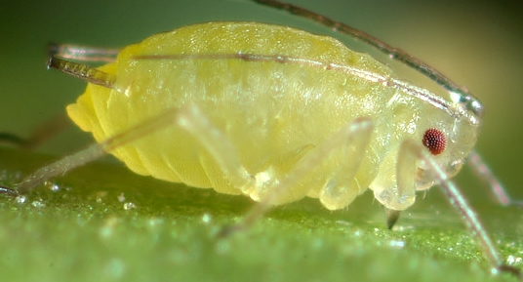

RNAseq (3 biological reps): Differential expression: “heads” vs “bodies”
5) Simple example: Differential gene expression
Heads
Contain salivary glands (secreted effectors)
Bodies (without nymphs):
Head
Body

Slide 26
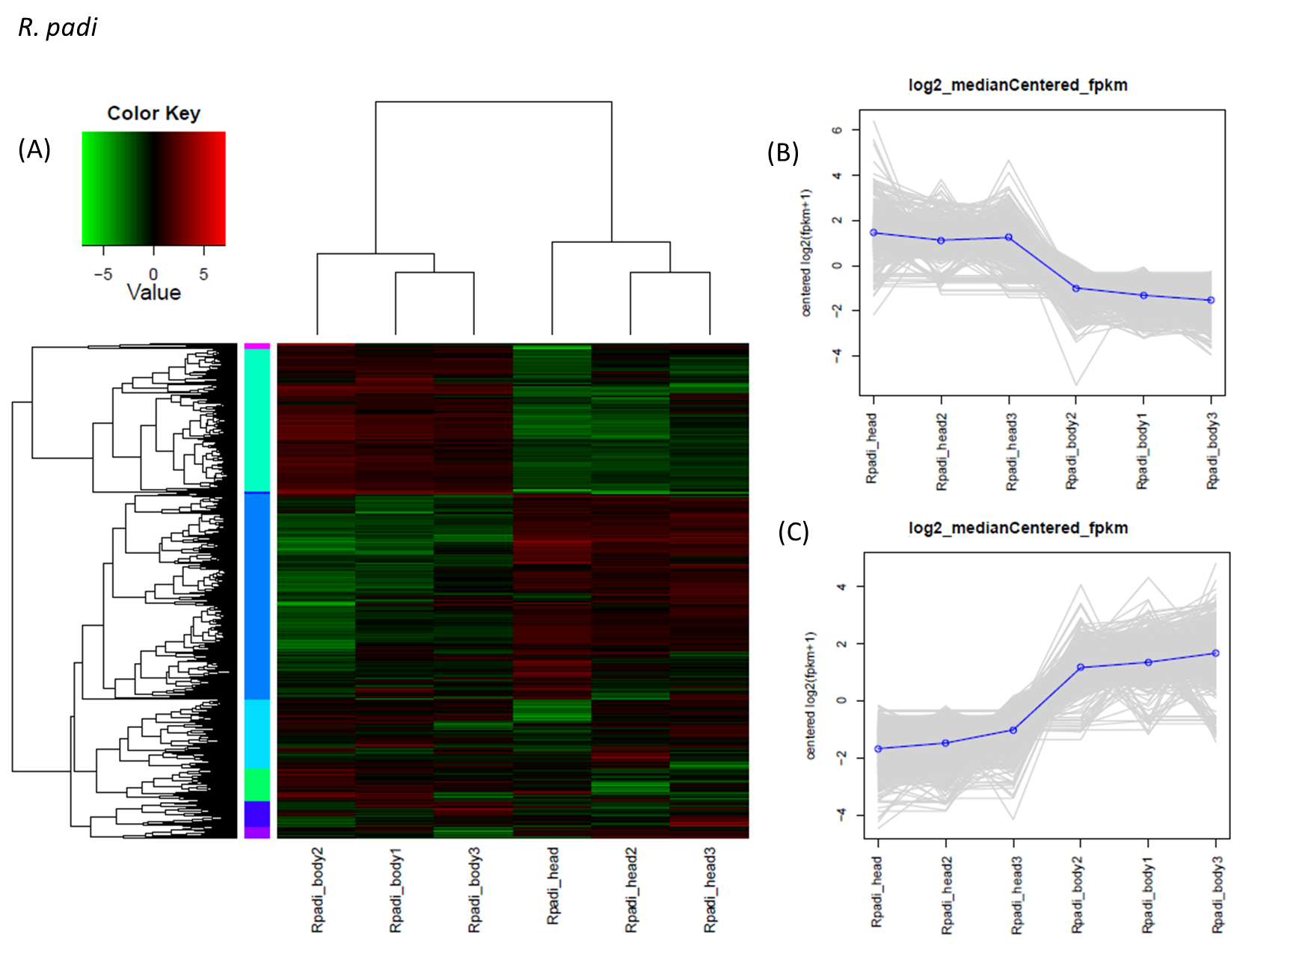
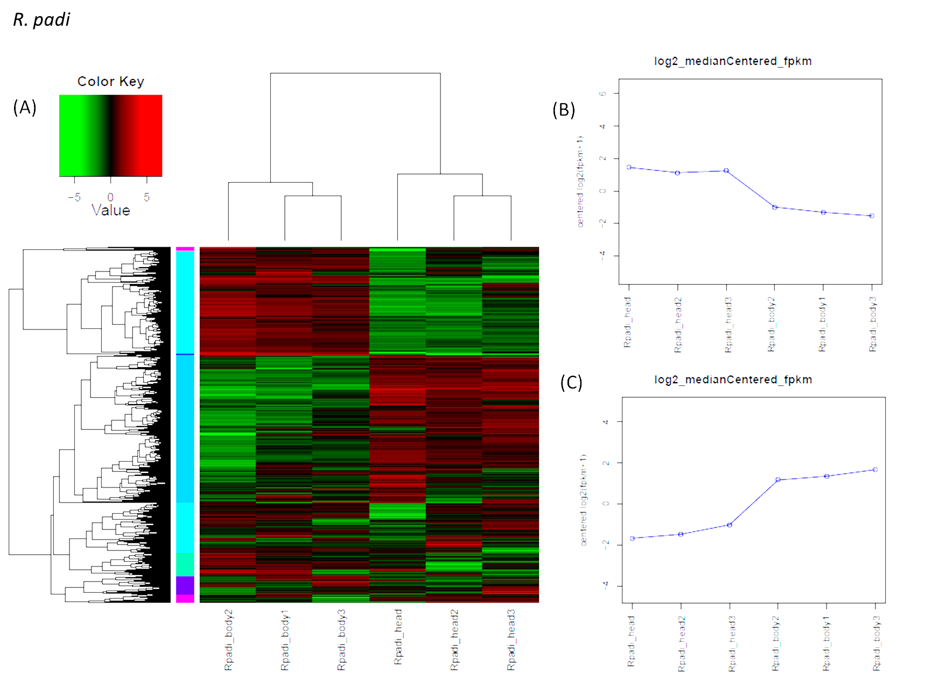
5) Simple example: Differential gene expression
A straight forward A vs B DE examples. In this case dissected heads versus Bodies, from Aphids. (A vs B is performed using an Exact test with multiple test correction).
https://en.wikipedia.org/wiki/Exact_test#:~:text=In%20statistics%2C%20an%20exact%20(significance,statistic%20is%20based%2C%20are%20met.

Slide 27
5) Differential gene expression
A straight forward A vs B DE examples. In this case dissected heads versus Bodies, from Aphids. (A vs B is performed using an Exact test with multiple test correction).

Slide 28
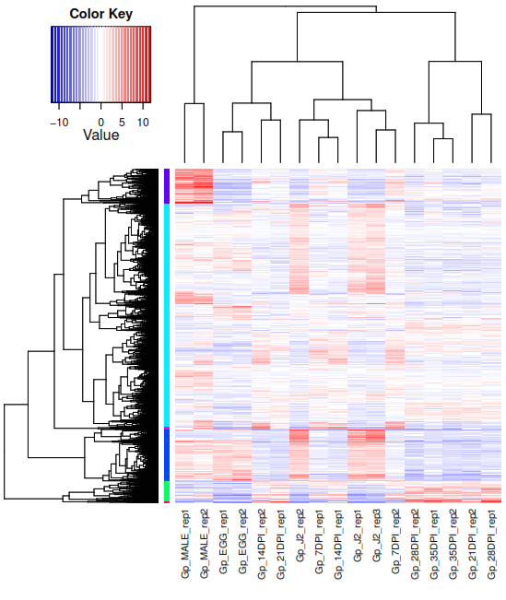
5) More complex: Differential gene expression
Genes with have statistically greater difference between conditions are considered DE
The relative LOG fold change of these DE gene can be plotted on a heat map. Scale LOG -10 to LOG +10 (blue to red) fold change difference.
https://www.bioconductor.org/packages/release/bioc/vignettes/edgeR/inst/doc/edgeRUsersGuide.pdf

Slide 29
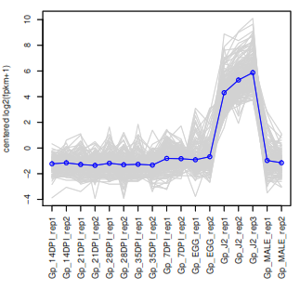
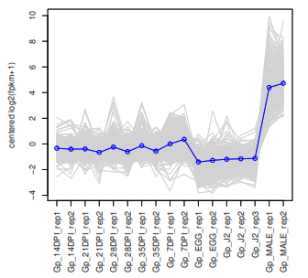
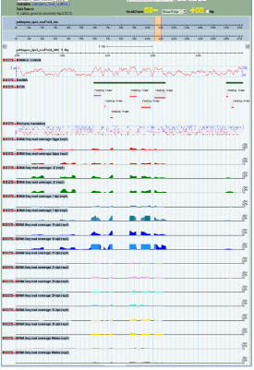
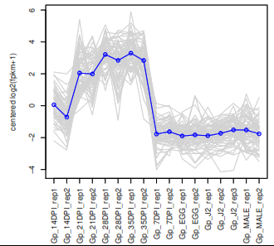
5) Differential gene expression
The expression of these genes can be “split” based of similar profiles.
Plot of expression clusters.
Life stage of interest.

Slide 30
5) Differential gene expression
Tools have been developed to identify DE genes over any number of different conditions (it is also possible to do GLM or ANOVA likwe analysis to compare many conditions). https://academic.oup.com/nar/article/46/8/e46/4829696
RNentropy: an entropy-based tool for the detection of significant variation of gene expression across multiple RNA-Seq experiments

Slide 31
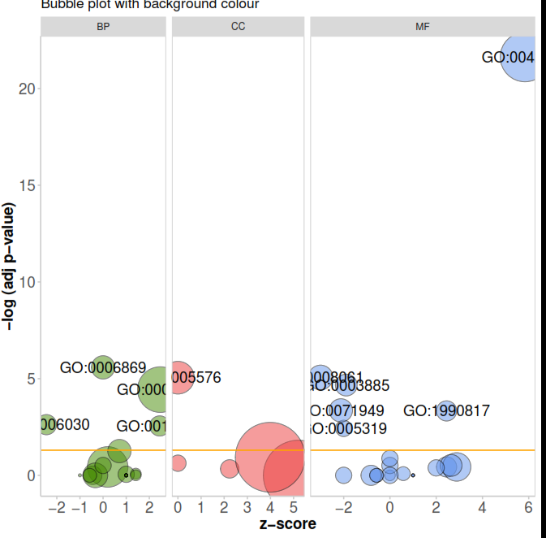
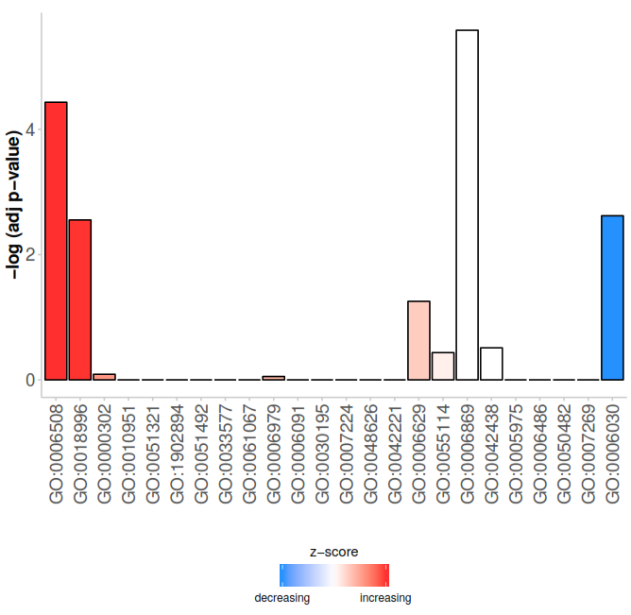
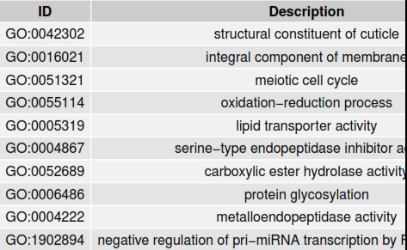
5) Differential gene expression: Gene Ontology (GO) enrichment of DE genes
GO terms assigned to genes are then compared against random sets to see if there is an enrichment or depletion in your DE gene set of interest.

Slide 32
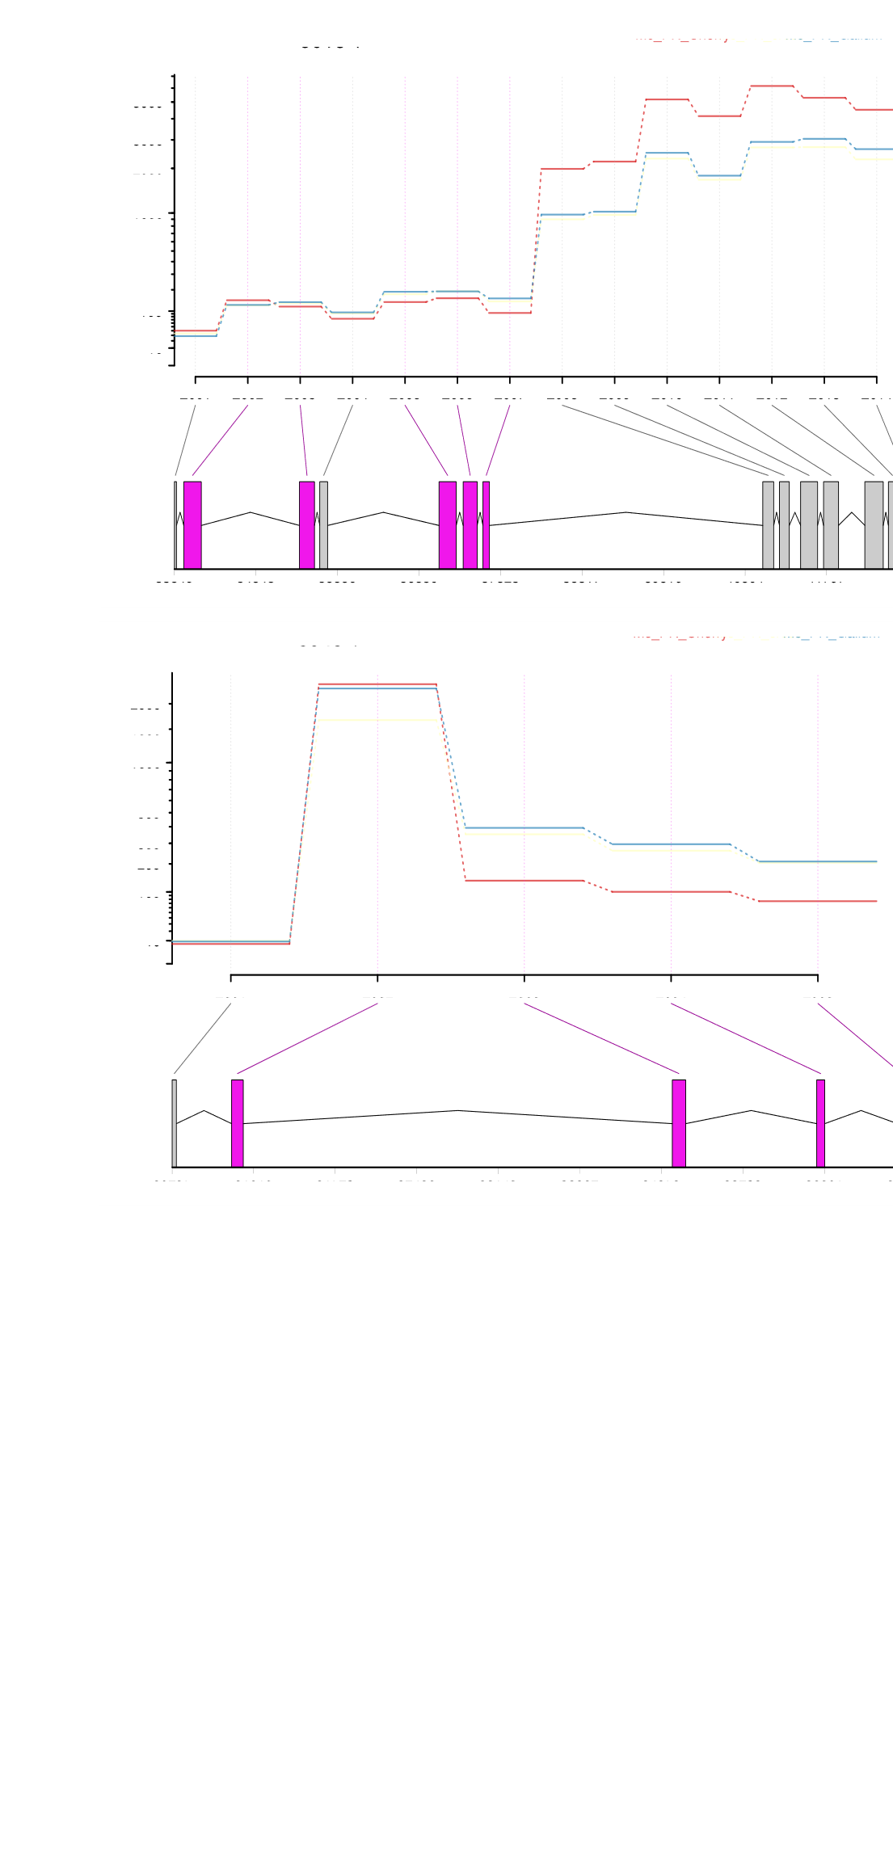
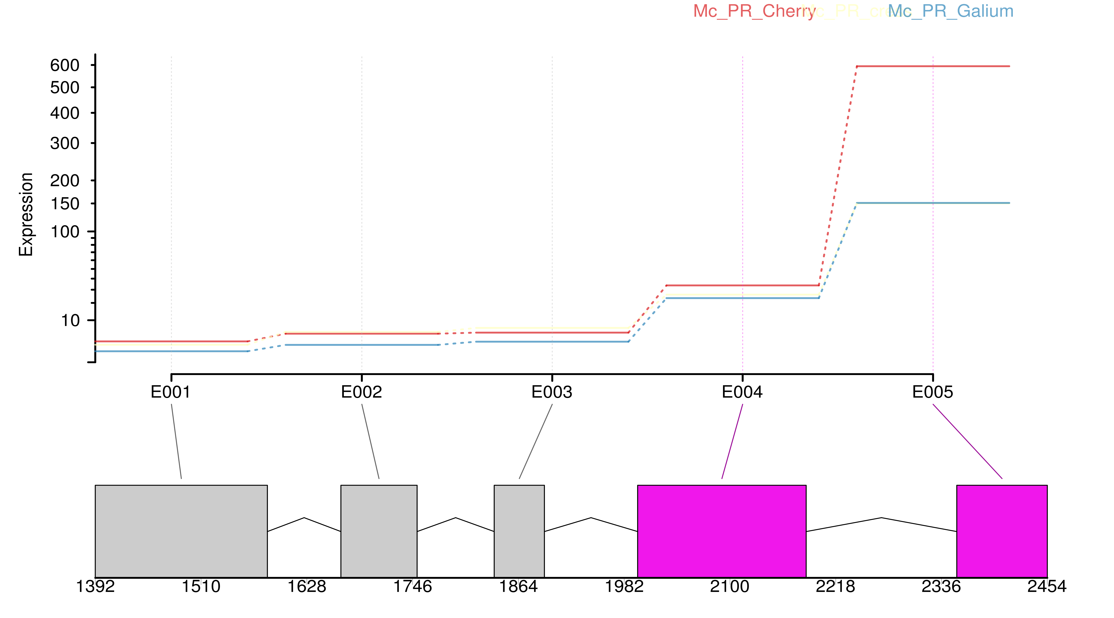
5) Differential exon expression
Following quantification of exon counts, using HTseq, differential exon expression can be performed using DEXSEQ (false discovery rate 0.001).
This can yield very localised results which may not be seen with DE gene expression.
Gene of interest (peroxidase): last exon DE in aphid between different hosts. Important for evading different host responses?
Thorpe, P., Escudero‐Martinez, C.M., Eves‐van den Akker, S. and Bos, J.I., 2020. Transcriptional changes in the aphid species Myzus cerasi under different host and environmental conditions. Insect Molecular Biology, 29(3), pp.271-282.

Slide 33
Overview
1: Gene structure
2: History (EST sequencing – Sanger) - brief.
3: Illumina
4: Biological reps, gene expression and counts
5: Differential expression between conditions
Ooops and extra one: RNAseq without a genome
6: RNAseq as a guide for gene calls
7: Nanopore and PacBio (long read) RNAseq – holy grail?

Slide 34
Oops: RNAseq DE without a genome
A de novo transcriptome assembly can be generated by assembling all the reads (without the genome – if one is not available).
The resulting transcript assembly should represent all the data, which all the conditions can now be mapped back to and used for DE analysis. - and therefore all that has previously been mentioned can then be applied here.
Eves-van den Akker, S., Lilley, C.J., Danchin, E.G., Rancurel, C., Cock, P.J., Urwin, P.E. and Jones, J.T., 2014. The transcriptome of Nacobbus aberrans reveals insights into the evolution of sedentary endoparasitism in plant-parasitic nematodes. Genome biology and evolution, 6(9), pp.2181-2194.
Thorpe, P., Cock, P.J. and Bos, J., 2016. Comparative transcriptomics and proteomics of three different aphid species identifies core and diverse effector sets. BMC genomics, 17(1), p.172.

Slide 35
Overview
1: Gene structure
2: History (EST sequencing – Sanger) - brief.
3: Illumina
4: Biological reps, gene expression and counts
5: Differential expression between conditions
Ooops and extra one: RNAseq without a genome
6: RNAseq as a guide for gene calls
7: Nanopore and PacBio (long read) RNAseq – holy grail?

Slide 36
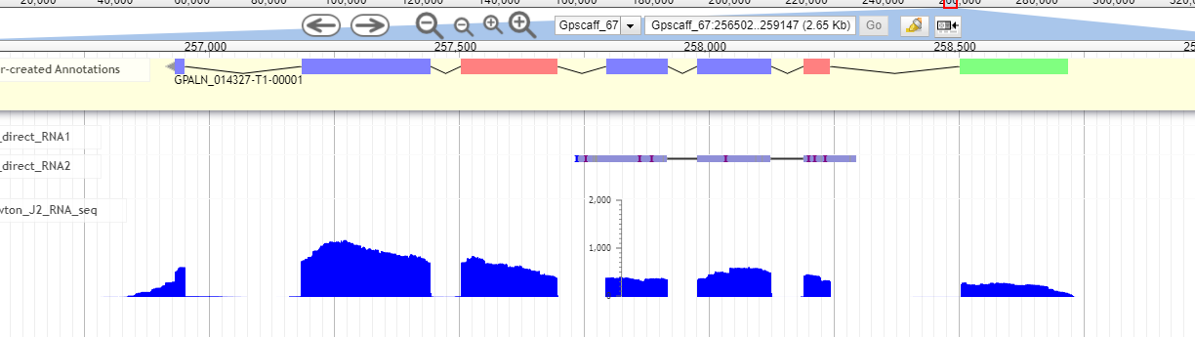
6) RNAseq to guide gene predictions
Modern gene callers can use the mapped RNAseq to guide gene prediction to help intron exon structure. Splice sites (rare ones can be detected - Eves-van den Akker, S., Laetsch, D.R., Thorpe, P., Lilley, C.J., Danchin, E.G., Da Rocha, M., Rancurel, C., Holroyd, N.E., Cotton, J.A., Szitenberg, A. and Grenier, E., 2016. The genome of the yellow potato cyst nematode, Globodera rostochiensis, reveals insights into the basis of parasitism and virulence. Genome biology, 17(1), pp.1-23.)
It makes a huge difference!!! (Braker, Augustus, Codingquarry)

Slide 37
Overview
1: Gene structure
2: History (EST sequencing – Sanger) - brief.
3: Illumina
4: Biological reps, gene expression and counts
5: Differential expression between conditions
Ooops and extra one: RNAseq without a genome
6: RNAseq as a guide for gene calls
7: Nanopore and PacBio (long read) RNAseq – holy grail?

Slide 38
7) Long read RNAseq
Nanopore and PacBio generate long reads. Long enough to get full transcripts, start to end (be careful of degradation, covert to cDNA? – PCR bias): https://nanoporetech.com/applications/rna-sequencing
Problem: accuracy and more importantly indels.
Indels: This is where a run of 6 or 9 (depending on the Nanopore model) bases in a row occurs. Nanopore detect bases based on current and does not have a time dimension to assess how long those bases took to go through the pore. Therefore, anymore than 6 or 9 of the same nucleotides in a row – it guesses. Get it wrong: Frame shift, deletion, insertion … if in coding sequence = incorrect protein coding sequence (bad!)
Soneson, C., Yao, Y., Bratus-Neuenschwander, A., Patrignani, A., Robinson, M.D. and Hussain, S., 2019. A comprehensive examination of Nanopore native RNA sequencing for characterization of complex transcriptomes. Nature communications, 10(1), pp.1-14.
Depledge, D.P., Srinivas, K.P., Sadaoka, T., Bready, D., Mori, Y., Placantonakis, D.G., Mohr, I. and Wilson, A.C., 2019. Direct RNA sequencing on nanopore arrays redefines the transcriptional complexity of a viral pathogen. Nature communications, 10(1), pp.1-13.

Slide 39
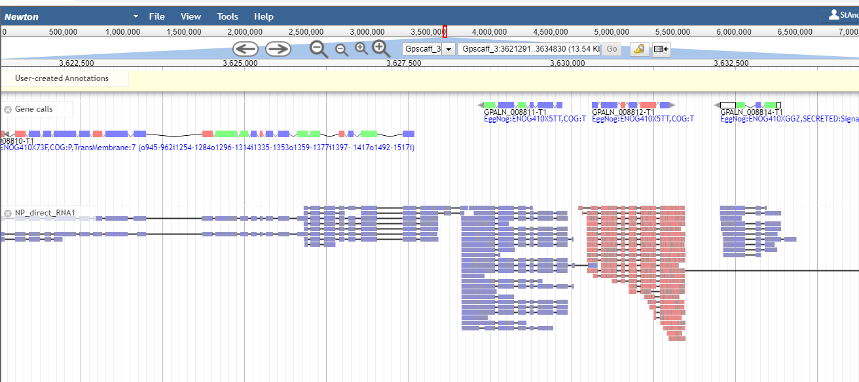
7) Long read RNAseq: Indels
Indels: Polishing with Illumina, Illumina specific bias back into the data set.
Long reads span the whole gene

Slide 40
Overview
1: Gene structure
2: History (EST sequencing – Sanger) - brief.
3: Illumina
4: Biological reps, gene expression and counts
5: Differential expression between conditions
Ooops and extra one: RNAseq without a genome
6: RNAseq as a guide for gene calls
7: Nanopore and PacBio (long read) RNAseq – holy grail?
Extra stuff

Slide 41
Application of RNAseq data: lot more than just these
Differential expression between conditions (or groups of)
Cancer cell line/ patient: Haplotyping of HLA alleles (current project): Szolek, A., Schubert, B., Mohr, C., Sturm, M., Feldhahn, M. and Kohlbacher, O., 2014. OptiType: precision HLA typing from next-generation sequencing data. Bioinformatics, 30(23), pp.3310-3316.
TSS: Liu, Y., Han, D., Han, Y., Yan, Z., Xie, B., Li, J., Qiao, N., Hu, H., Khaitovich, P., Gao, Y. and Han, J.D.J., 2011. Ab initio identification of transcription start sites in the Rhesus macaque genome by histone modification and RNA-Seq. Nucleic acids research, 39(4), pp.1408-1418.
Gene fusions (cancer): Heyer, E.E., Deveson, I.W., Wooi, D., Selinger, C.I., Lyons, R.J., Hayes, V.M., O’Toole, S.A., Ballinger, M.L., Gill, D., Thomas, D.M. and Mercer, T.R., 2019. Diagnosis of fusion genes using targeted RNA sequencing. Nature communications, 10(1), pp.1-12.
SNP calling: Identifying gene with greater SNP per base frequency. Pokhare, S.S., Thorpe, P., Hedley, P., Morris, J., Habash, S.S., Elashry, A., Eves‐van den Akker, S., Grundler, F.M. and Jones, J.T., 2020. Signatures of adaptation to a monocot host in the plant‐parasitic cyst nematode Heterodera sacchari. The Plant Journal, 103(4), pp.1263-1274.
Single cell RNAseq: Arzalluz-Luque, Á. and Conesa, A., 2018. Single-cell RNAseq for the study of isoforms—how is that possible?. Genome biology, 19(1), p.110.

Slide 42
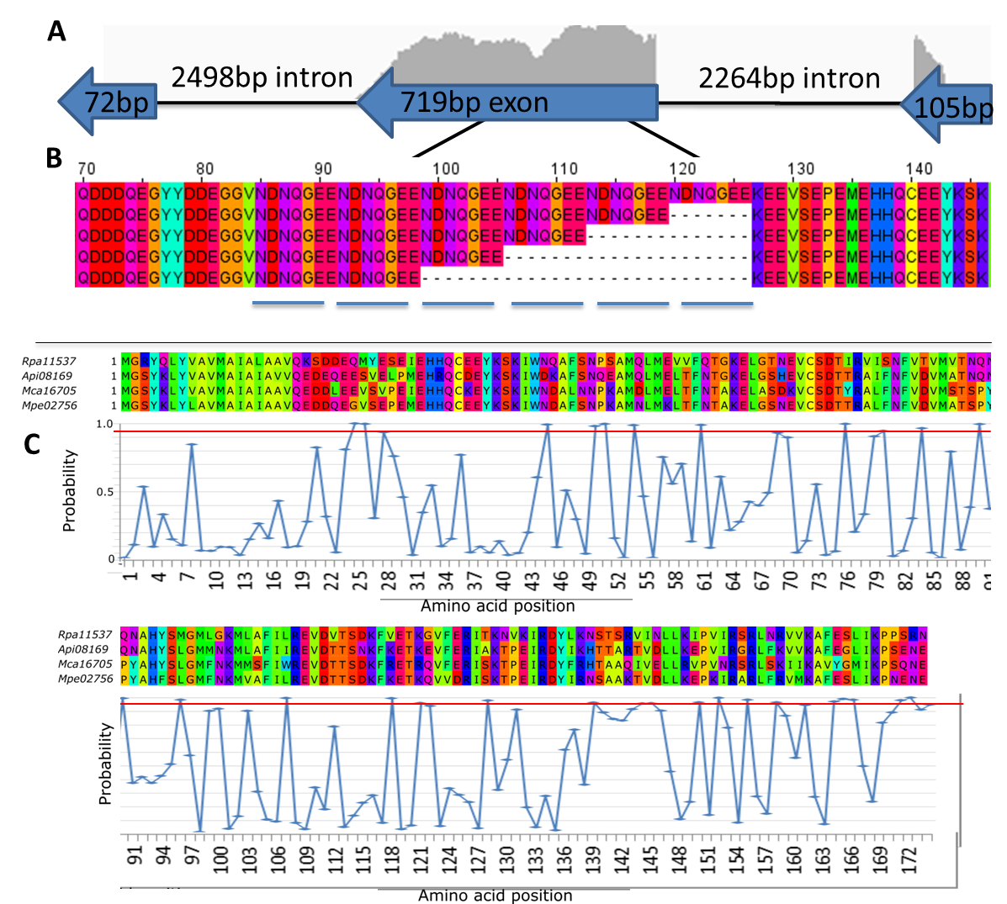
Site specific selective pressure
Identify genes (transcripts) under selective pressure and specifically the site in the transcript most likely to be under selection pressure

Slide 43
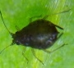
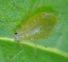
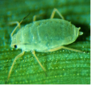
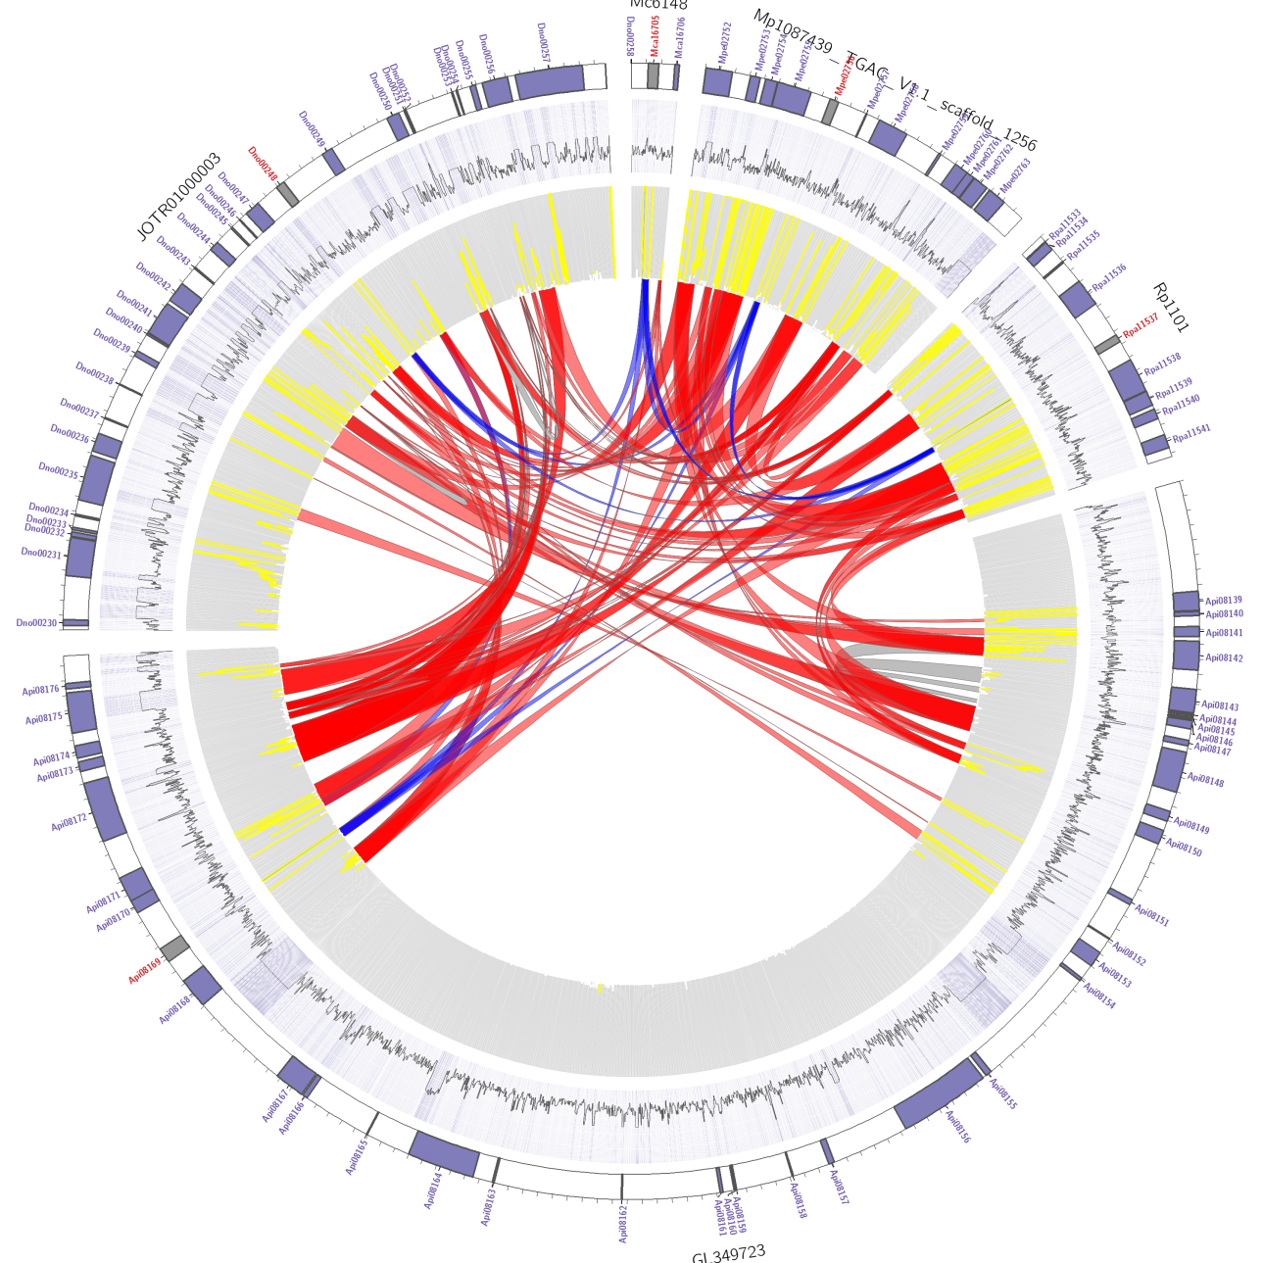

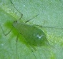
RNAseq cov: syntenic genes in red
Outer circle = genes
Middle circle = GC content
Inner circle = RNAseq cov (yellow)
Species similarity = red bands
Gene duplication = grey bands
M. cerasi
M. persicae
Wheat aphid
R. padi
C002: single copy in all aphid genomes. (Coloured in RED) C002
Incorrect scaffolding of Pea aphid, a story for another time!?!
Yellow is RNAseq coverage
Pea aphid

Slide 44
THE END!!!!!!
In summary: RNAseq helps with biological questions.
A genome assembly without RNAseq is difficult to annotate. RNAseq helps!
So many applications, just try a google scholar search!
RNAseq is fun
The following has a whole load of slides which are related but not specifically RNAseq:

Slide 45
This DNA Sequencer Is Cheaper Than an iPhone. Conclusion: I Need to Learn Bioinformatics.
https://towardsdatascience.com/this-dna-sequencer-is-cheaper-than-an-iphone-conclusion-i-need-to-learn-bioinformatics-7e3d3895812a

Slide 46
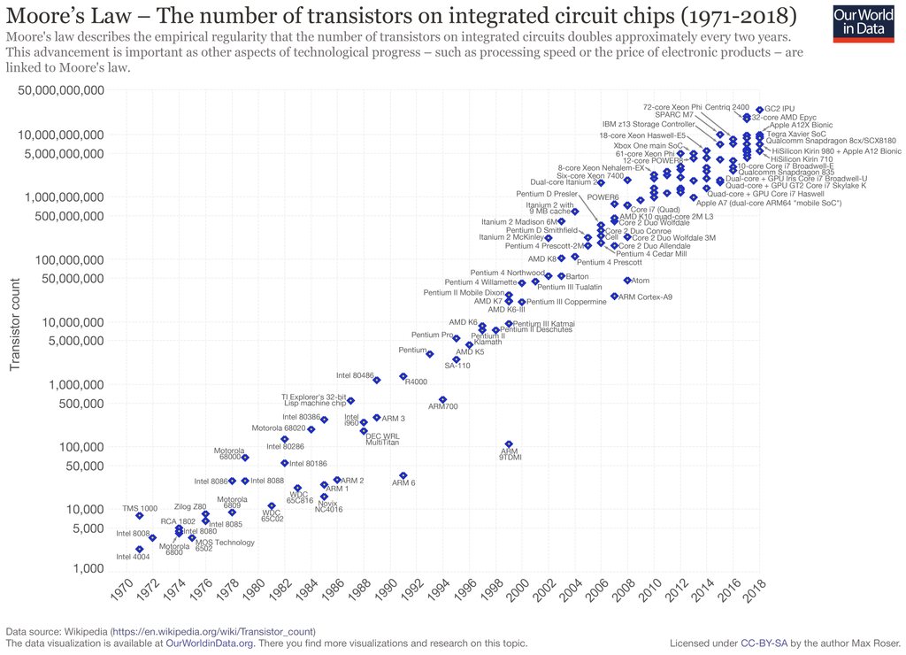

Slide 47
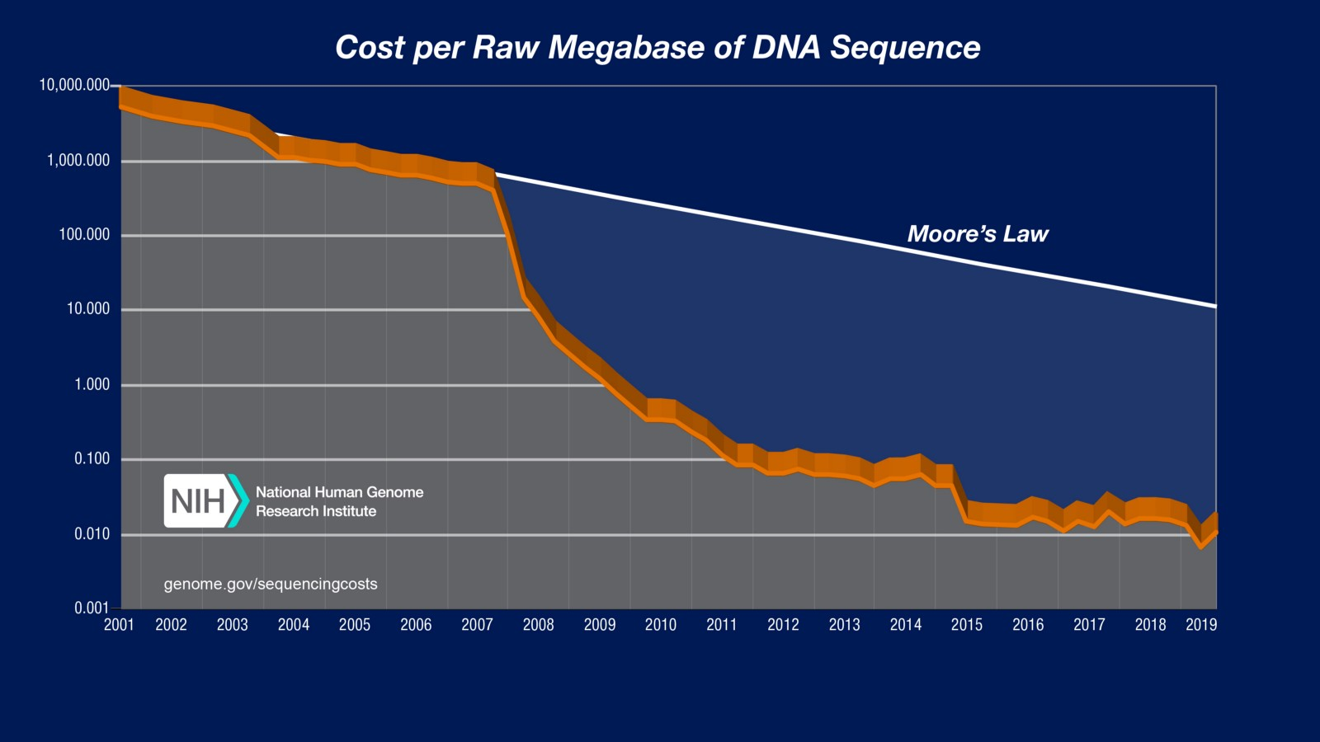
https://www.genome.gov/about-genomics/fact-sheets/Sequencing-Human-Genome-cost

Slide 48
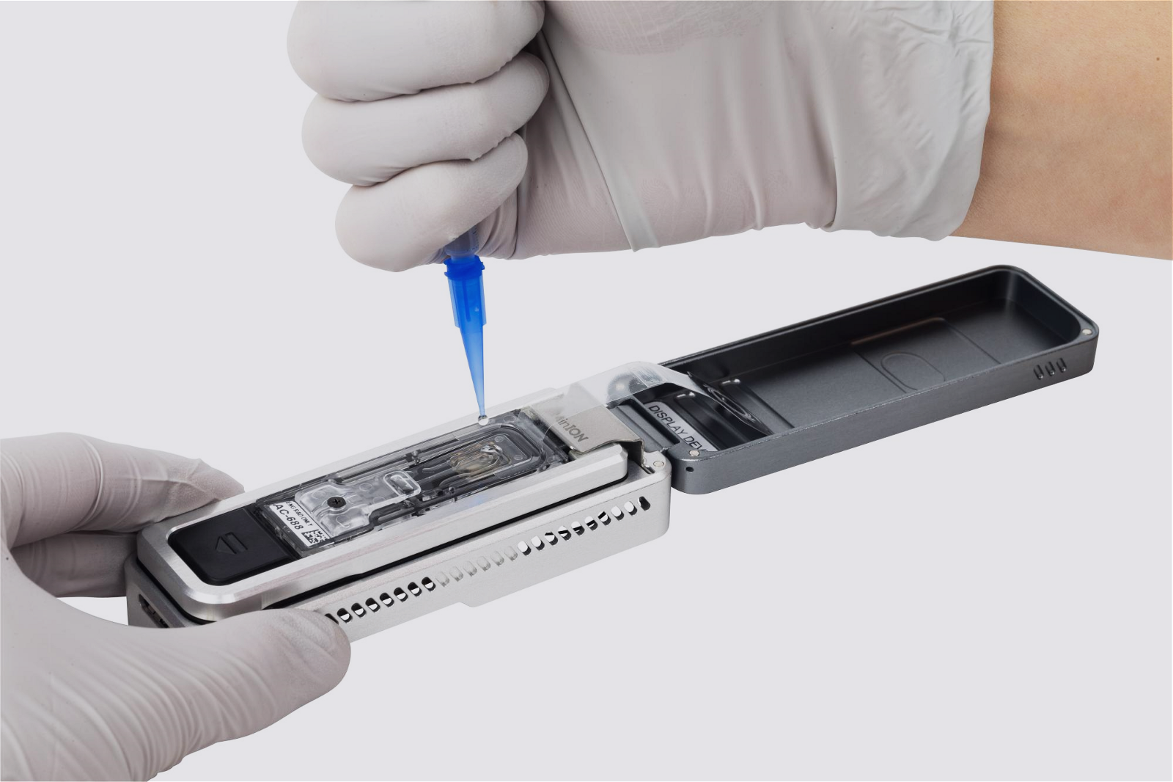
Nanopore

Slide 49
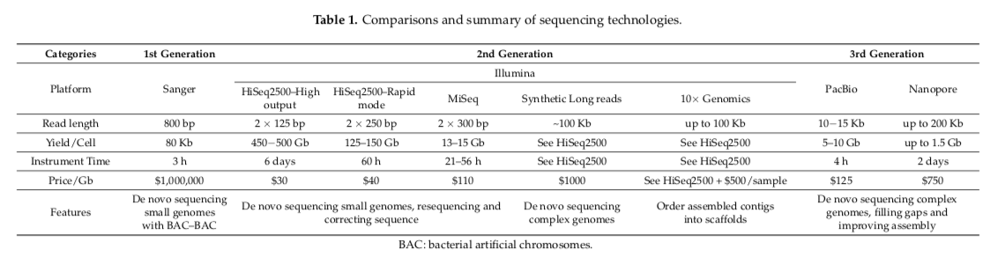
From Li, Changsheng & Lin, Feng & An, Dong & Wang, Wenqin & Huang, Ruidong. (2017). Genome Sequencing and Assembly by Long Reads in Plants. Genes. 9. 6. 10.3390/genes9010006. https://www.ncbi.nlm.nih.gov/pubmed/29283420 (note that the price/Gb for Nanopore is probably wrong — see below)

Slide 50
